Slide 1
What If The Internet Stopped Working

Slide 2
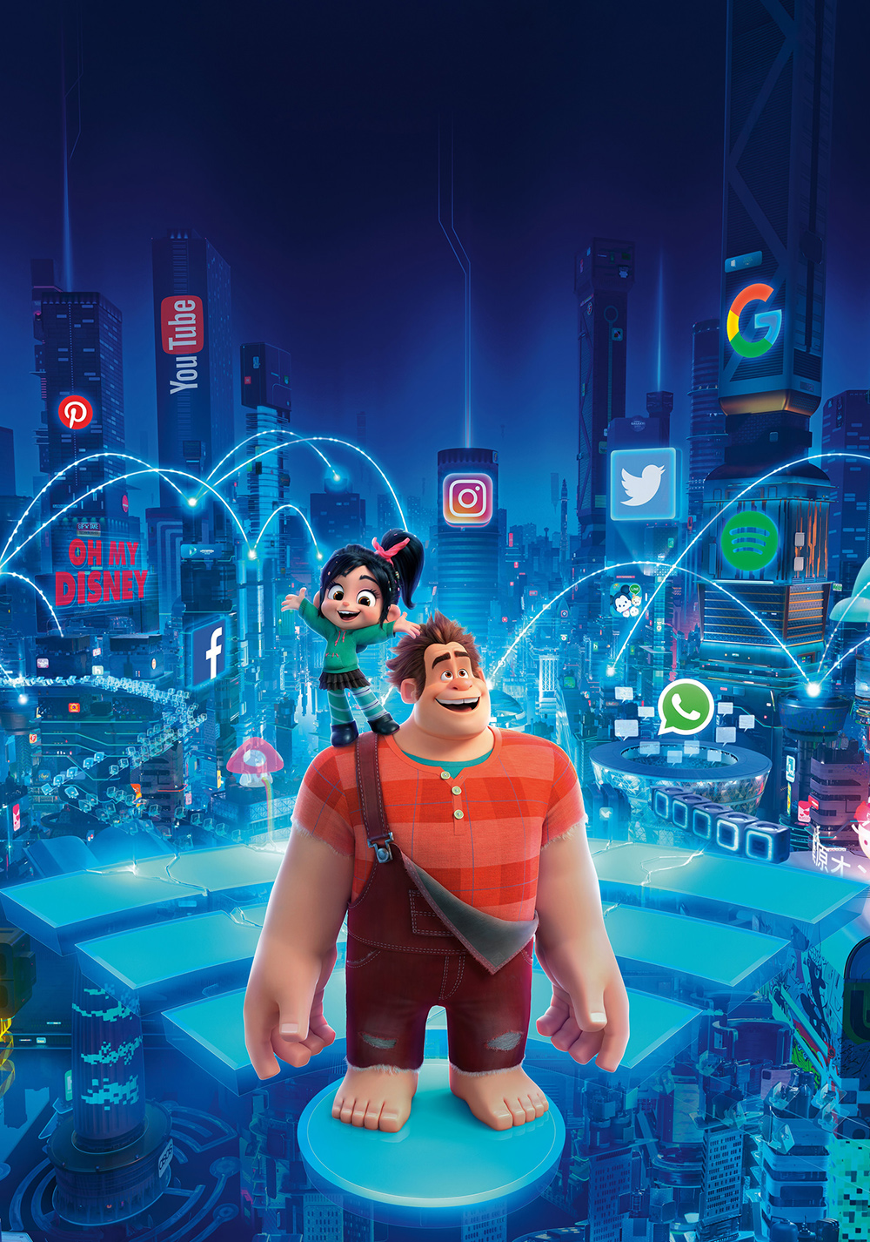
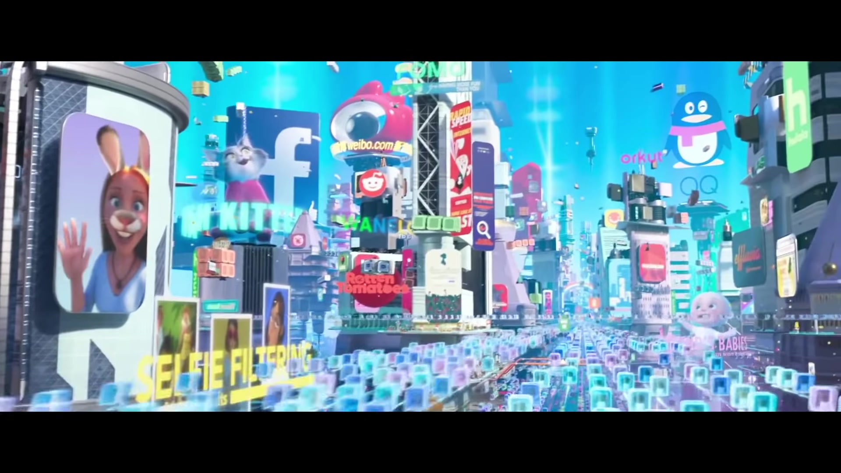
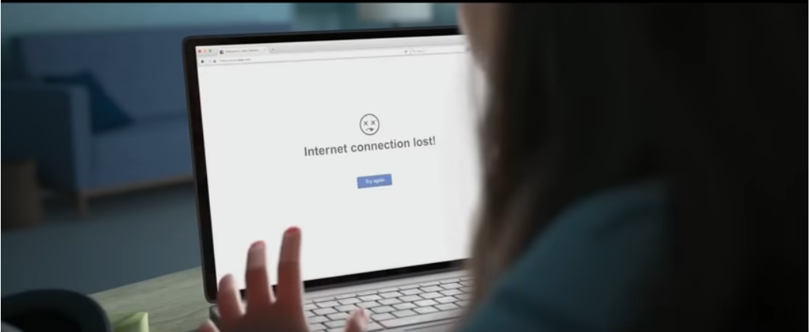
Ralph Breaks the Internet

Slide 3
What If The Internet Stopped Working now?
From My Point Of View
At first, I think it is not a big deal
Lot People Still Don't Have Internet Access
Walk Out From The Virtual World
Will not Receive Useless Information
Disclosure Less Privacy
But after careful consideration, I draw a conclusion
We Can't Live Without The Internet

Slide 4








The Changes In Our Daily Life
7:00
Wake up

Slide 5


8:00
Wake up

Slide 6
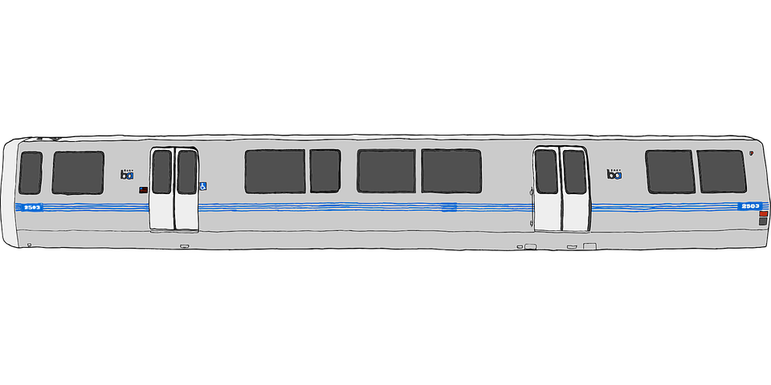


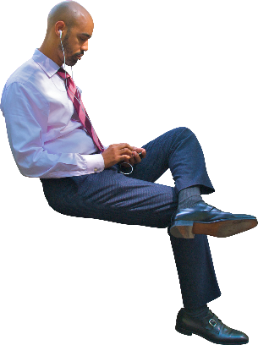



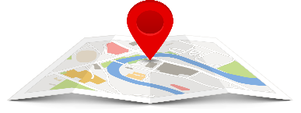

Slide 7


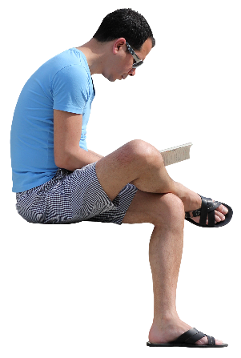
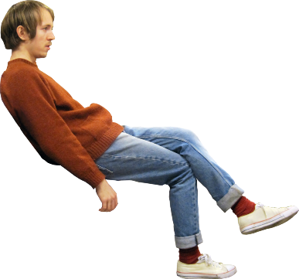
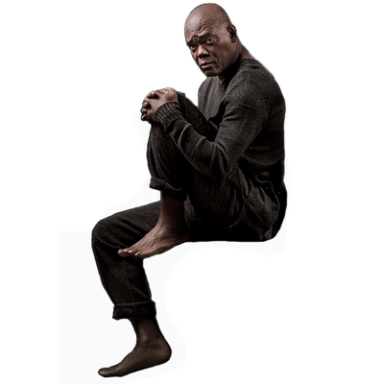
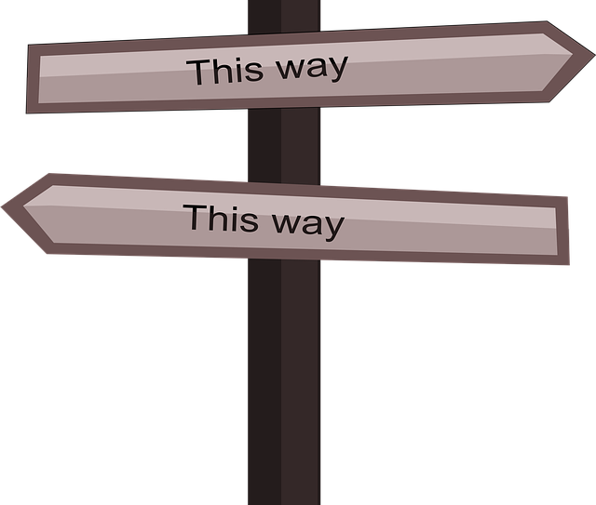

Slide 8

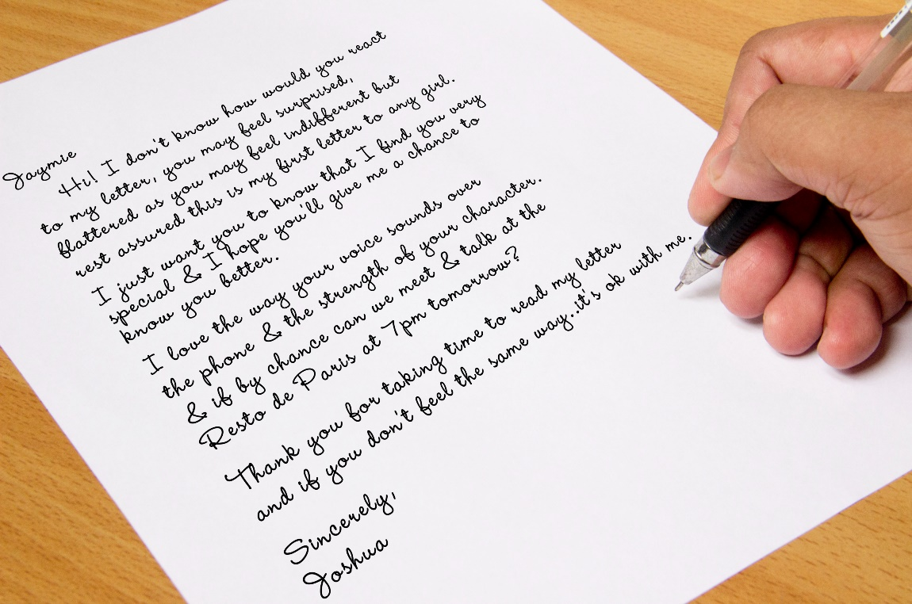
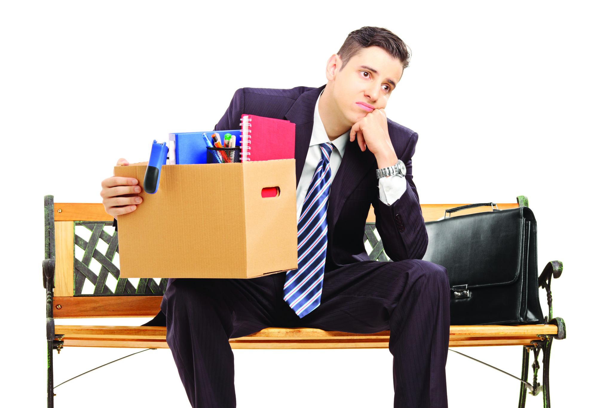
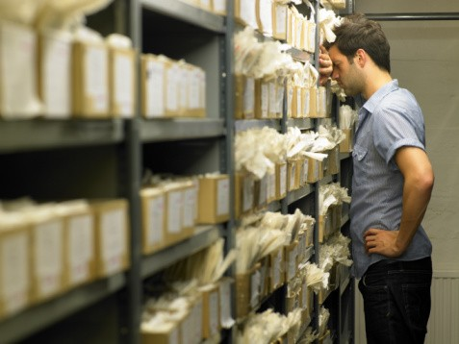
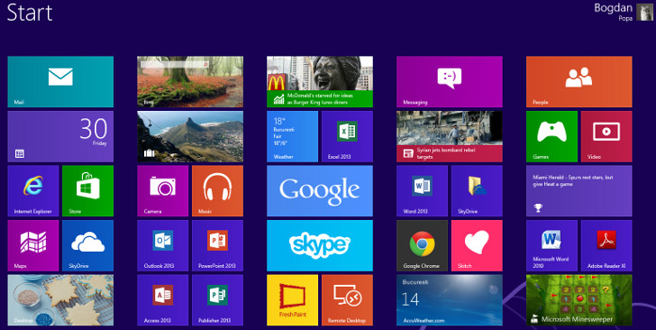

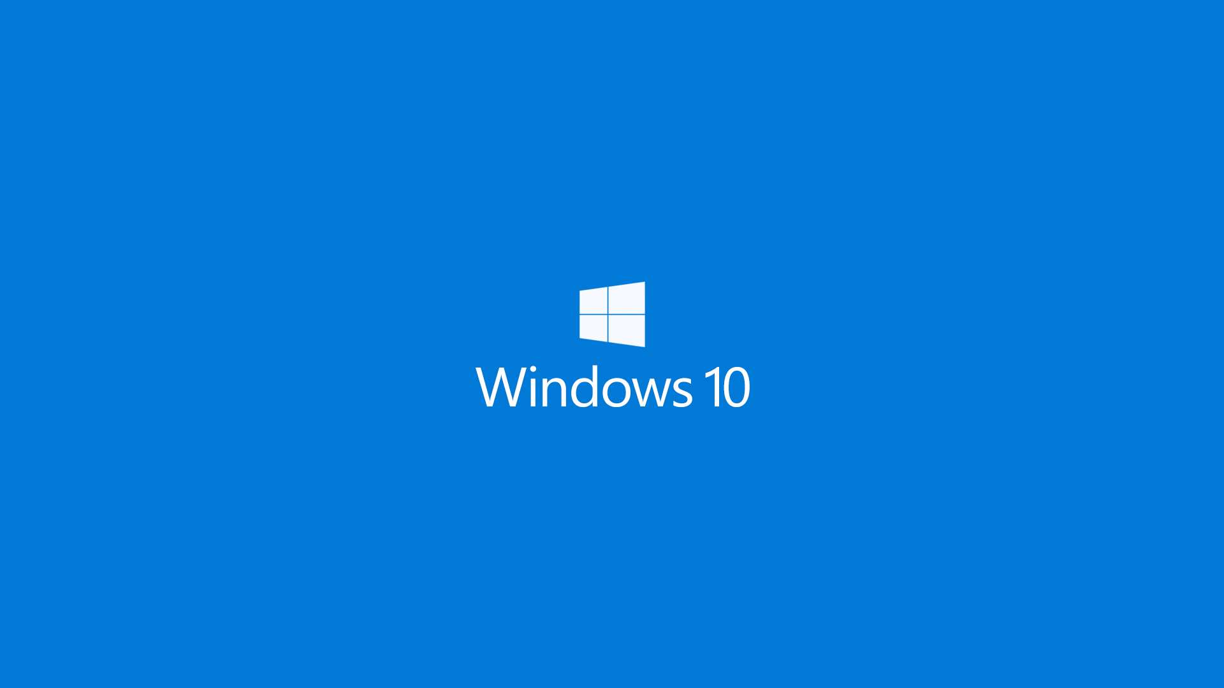

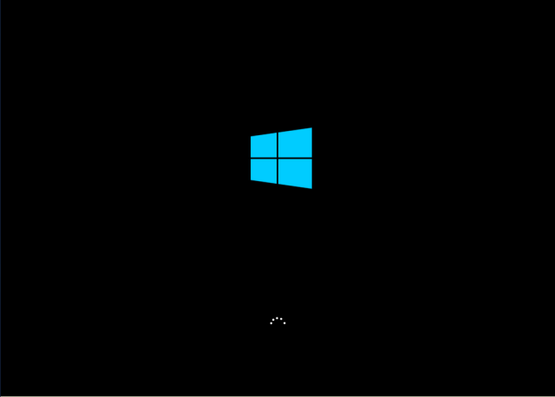

Slide 9
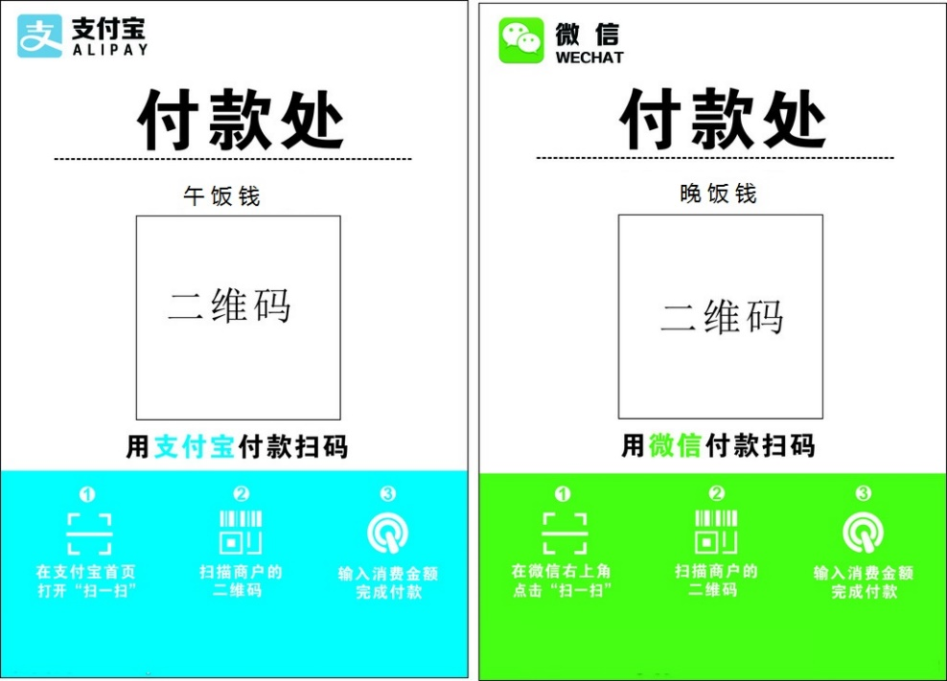
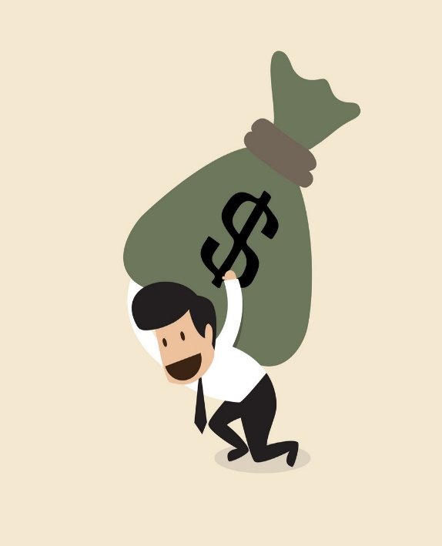


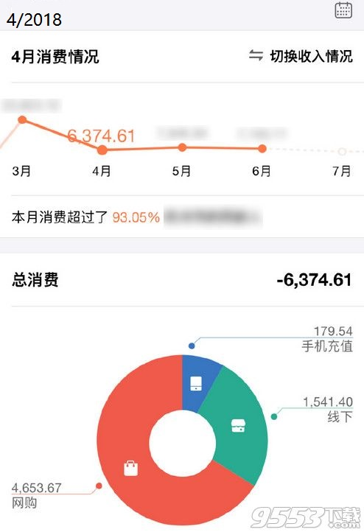



Slide 10
The Changes In The World
Video.Mp4

Slide 11
At Last Part
Maybe， Internet will never stop working
Why should we explore this topic?
(1)Rethink about our familiar world and get a new understanding.
(2)Be aware of unexpected development of the Internet (3)we are the witness of development of the Internet

